Slide 1
APAC Benefits Strategy Study Webinar

Slide 2



Introduction
Ken Wong
Principal and Actuary
Aon
ken.wong.2@aonhewitt.com
Rice Loh
Principal and Actuary
Aon
rice.loh@aonhewitt.com

Slide 3
Housekeeping
Audio broadcast is through the computer. Please be sure to increase the audio volume from your computer
Please submit questions at any time by typing them in the “Q&A” text field and clicking “Send”
Please click on “Help” on the menu for technical assistance

Slide 4
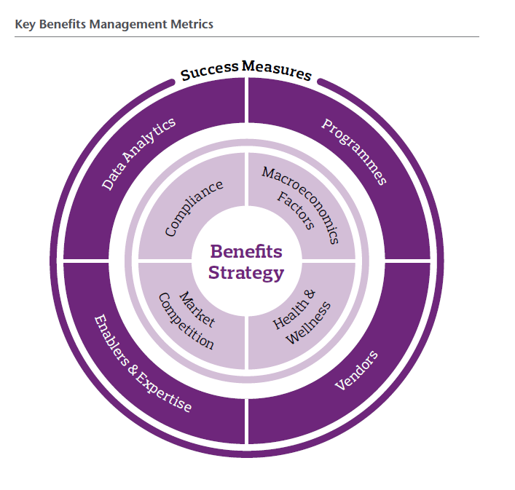
Study Background
This study was carried out over Q4 2016 and covered the following key benefits metrics
benefit metric
60 percent of organisations have established global benefits policies and guidelines
But only one in five respondents are confident their plans are aligned
Most cite:
  Lack of available data
  Lack of understanding of plan costs and risks
  Resource constraints and lack of expertise
Notes:
Key Points to Note:
Recent global survey suggests 60% of firms have established benefit policies/guidelines but most struggle on execution (1 in 5)
Key reasons are (i) data (ii) lack of understanding of programme costs and risks, (iii) Resource constraints and lack of expertise.
This study aims to understand how leading company professionals in APAC execute on their corporate benefits strategy , and whether they face similar challenges
This study was carried out via an online questionnaire Q4 of last year and covers these key metrics in this graphic

Slide 5
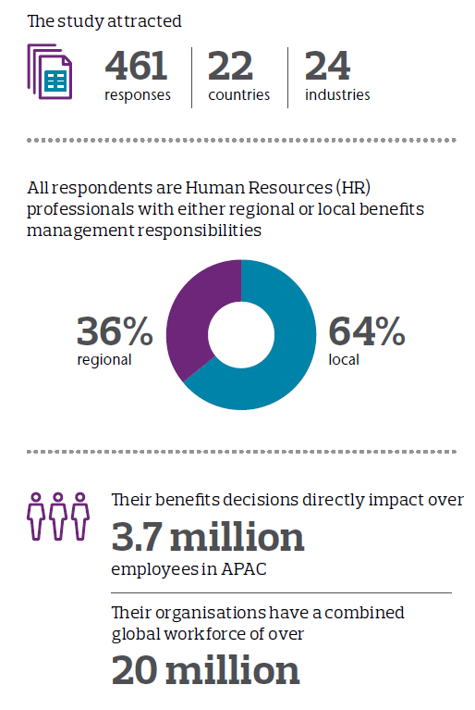
Participant Profile
The largest study of its kind in APAC
Extensive geographic and industry spread
Both local and regional views represented
Participants highly influential within their organisation
Notes:
Key Points to Note:
With the focus on strategy execution, we believe this is the latest study of its kind in APAC. 461 responses total
With an extensive geographic and industry spread, 22 countries and 24 industries represented.
Our responses include both local and regional professionals, and highly influential within their organization - directly managing benefits for around 3.7 million employee in APAC. In total our respondents work for MNCs that have over 20 million employees globally.

Slide 6
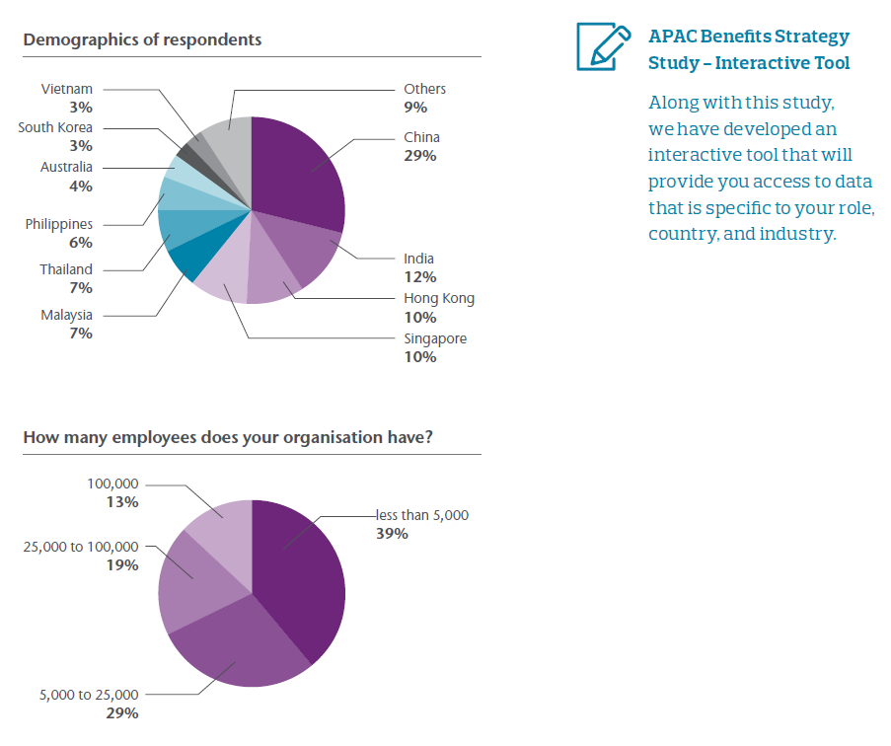
Participant Profile
APAC Benefit Strategy Study – Interactive Tool
Detailed Results by:
Role
Industry
Country
Reach out to your Aon Consultant
Notes:
Key Points to Note:
Here are some country and size related stats…
Given we have gather such a diverse set of responses we decided to analysis results via our Aon analytics platform which allows us to interactively see results by respondent role, industry and country
We are excited to show you this during the interactive part of this Webinar. We won’t be able to drill down into all industries but your regular Aon consultant will also have access to this tool…
Feel free to reach out to them if you would like to see results for that aligns with your particular situation and industry

Slide 7
Poll
During the interactive section, which country and industry would you like to see further results on ?
Notes:
Key Points to Note:
Which brings us to our interactive poll
[Provide instructions to answering this question via WebEx]
We will tally up the poll in the background and during the interactive session we will drill own into the country / industries that got the most votes
Now onto aggregate results from our Study…

Slide 8
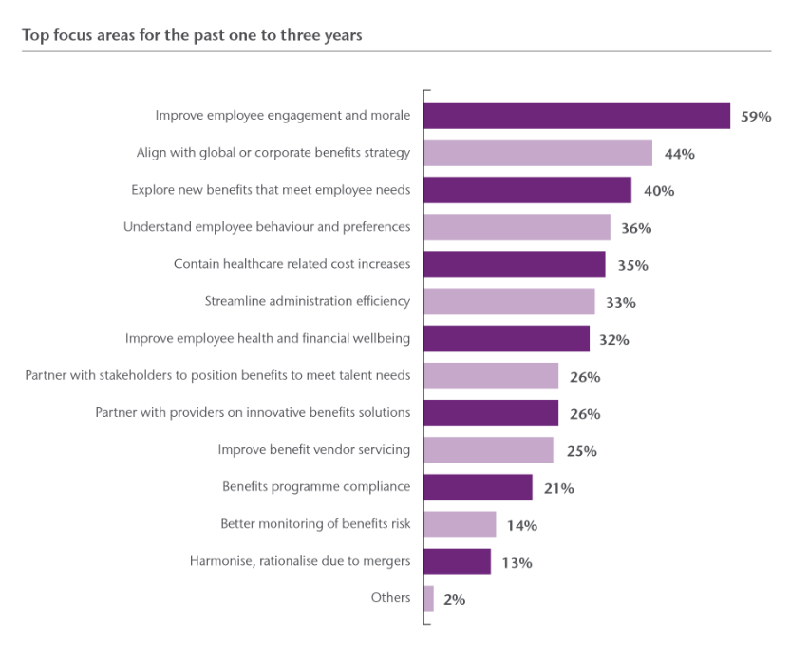
Top Focus Areas (Past One to Three Years)
Improve Employee Engagement
Alignment to Strategy
Explore Benefits that Meet Employee Needs
Notes:
Key Points to Note:
We asked participants their top focus areas for the recent 1-3 years
We asked participants to pick up to 5 focus areas from this list. We then weighted their selections based on how many they actually selected. The % is calculated by added up the weighted selections and dividing it by total number of selections. A sort of Relative Importance Score if you will…
The top 3 are improving engagement, alignment with corporate strategy and exploring new benefits that meet employee needs
What is interesting is what respondent feel are least important. These are marked here… very interesting indeed.
So why the focus on improving employee engagement …?

Slide 9
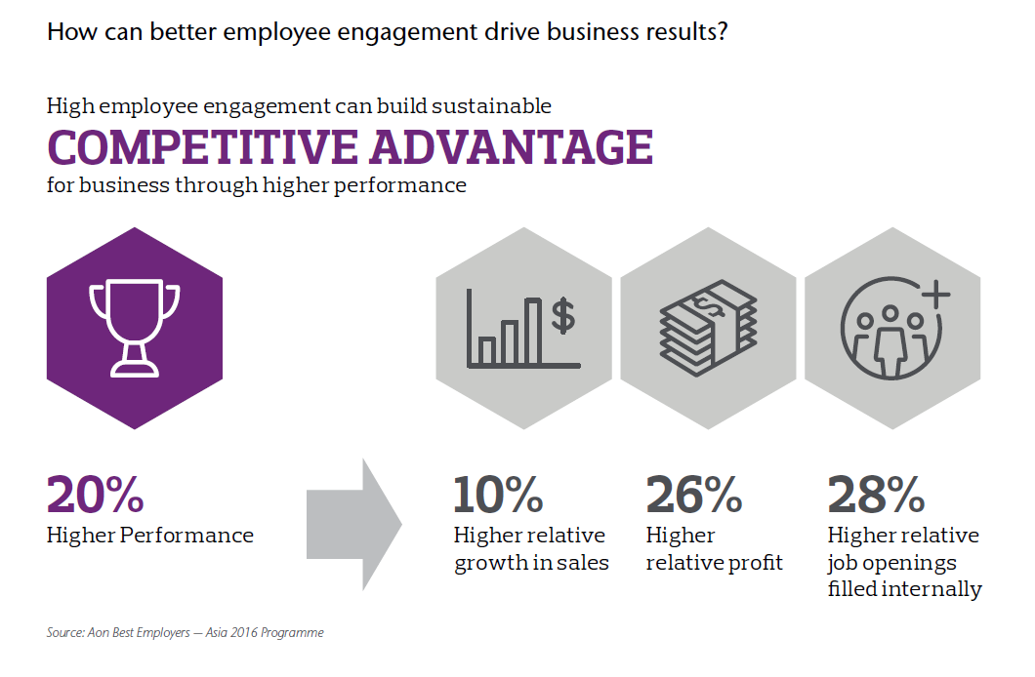
High Employee Engagement
Notes:
Key Points to Note:
In our recent Best Employer survey in APAC, organization with high employee engagement see higher corporate performance and ultimately contribute to a stronger bottom line.
It’s quite compelling really, with significant higher growth in sales, profit and lower turnover.
If you are interested in finding out what makes a Best Employer in your country, please reach out and we will connect you with one of our engagement expert.

Slide 10
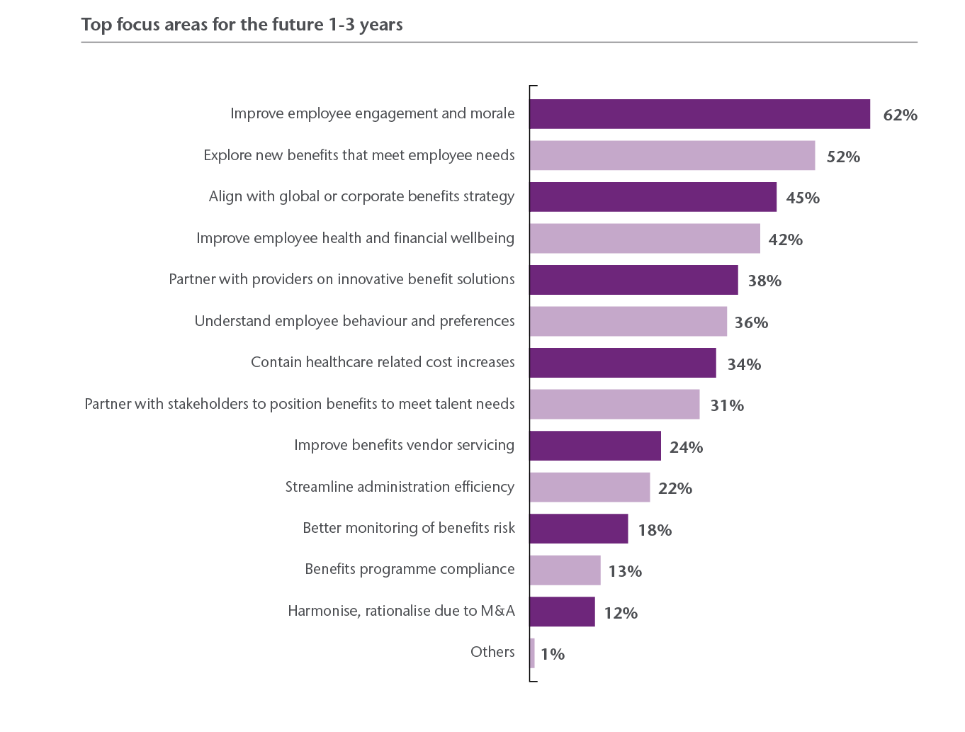
Top Focus Areas (Future one to three years)
Improve Employee Engagement
Explore Benefits that Meet Employee Needs
Improve Employee Health and Financial Wellbeing
Partner on Innovative Solutions
Notes:
Key Points to Note:
Looking ahead, the top focus area in future continue to be improving employee engagement
Exploring benefits that meet employee needs, improve health and financial wellbeing, and partner on innovative solutions have moved up in the rankings
Interestingly, towards the bottom are improving vendor servicing, streamlining admin efficiency, benefit compliance, M&A work.
The inference is that the day-to-day execution and management of benefit programs are a “given” and that firms are trying to focus on designing and sourcing innovative benefits for employees
The implications of this as we see it is that companies should lean on vendors to help them with the ‘basics’; like compliance and having efficient admin…thus leaving more time for the importance aspects of program design and exploring new benefits

Slide 11
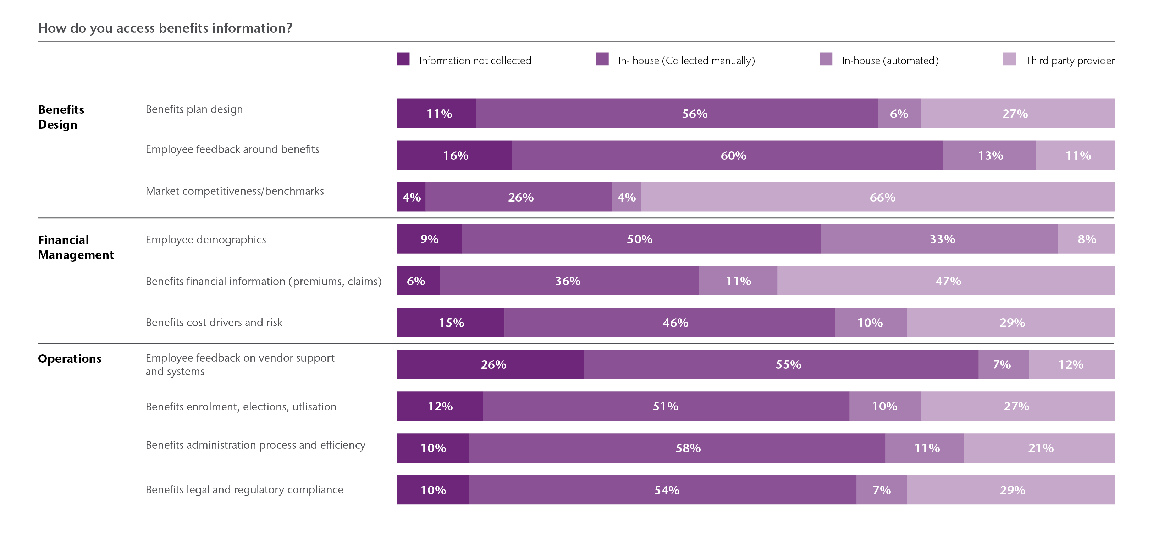
Benefits Information Access
Notes:
Key Points to Note:
Moving onto how participants access information in managing their benefit programs. By far the most predominant approach is gathered in-house and on a manual basis.
26% of participants, or 1 in 5, do not gather feedback on vendor support and systems
Companies lean on third party vendors, whether they be consultants, brokers or benefit vendors themselves, most for market competitiveness / benchmark and benefit financial information.
These results validate our recent client conversations around benefits technology. Companies are increasingly looking for solutions that both engage employees and streamline information collection.
So how satisfied are they with the benefits data they receive?

Slide 12
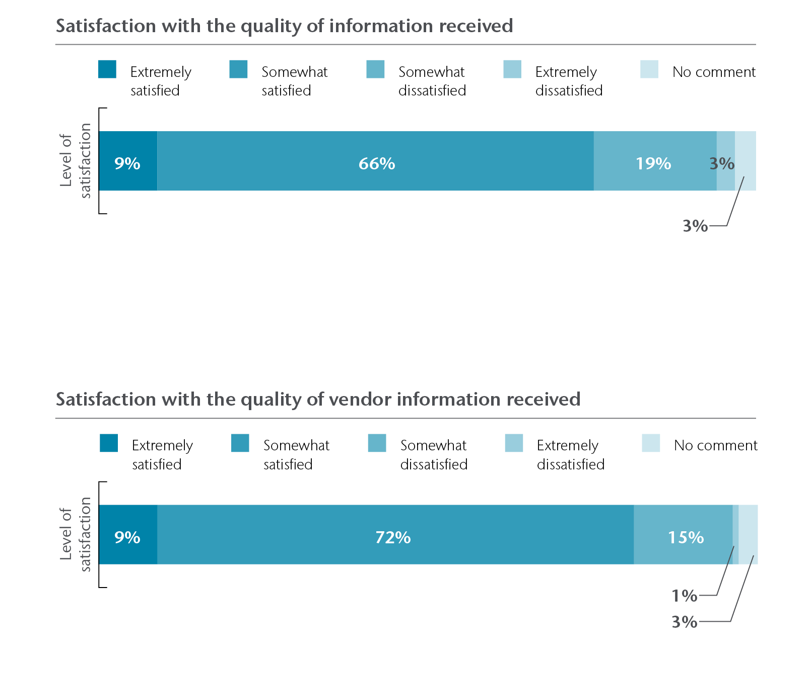
Quality of Information Received
75% Satisfied with Quality of Information Received
Higher on Information Received by Third Party Vendors
Leverage Vendor Expertise to Provide More Insights
Notes:
Key Points to Note:
In aggregate, 75% of extremely and somewhat satisfied with the quality of the data they receive.
Information received from third party vendors scored marginally higher on the satisfaction scale.
Beyond market competitiveness and compliance information, our view is that companies should leverage their third party vendors in gathering and providing more insights around benefit cost drivers, risks and employee feedback around design and experience.

Slide 13
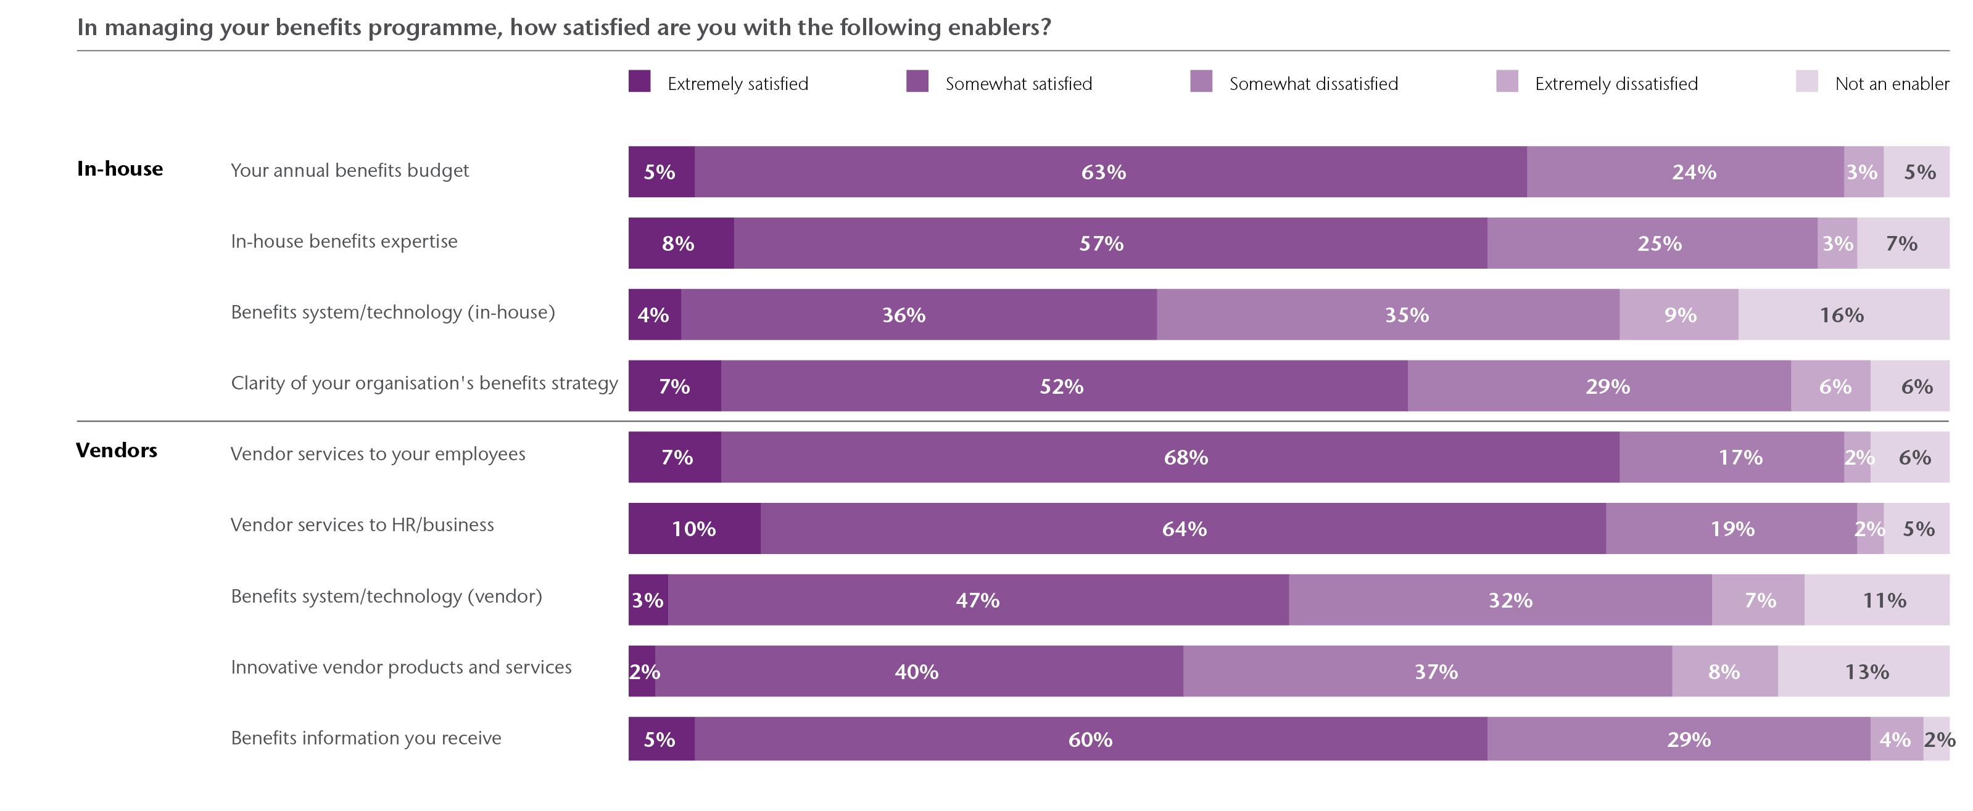
Benefits Expertise and Vendors
Notes:
Key Points to Note:
Organizations rate benefit vendors’ services to both employees and HR fairly highly. Benefit information received from vendors also scored relatively highly
Vendor’s technology and perceived ability to offer innovative benefits are seen as relatively weaker enablers.
In comparison, in-house enablers as a whole score lower satisfaction than external vendors
Even as annual budget and in-house benefits expertized, scored reasonably high
In our view, organizations should establish baseline Services Level Agreements for vendors’ services and support. They can then focus their vendor selection on product innovation and support technology as key enablers to support their benefits management
Organizations should look for these key characteristics….

Slide 14
Organisations should look out for:
Proven Admin SLAs
Clear Technology Roadmap
“Best in Class”
Client Servicing
Product Innovation
Scalable
Annual Reviews
Notes:
Key Points to Note:
Organizations rate benefit vendors’ services to both employees and HR fairly highly. Benefit information received from vendors also scored relatively highly
Vendor’s technology and perceived ability to offer innovative benefits are seen as relatively weaker enablers.
In comparison, in-house enablers as a whole score lower satisfaction than external vendors
Even as annual budget and in-house benefits expertized, scored reasonably high
In our view, organizations should establish baseline Services Level Agreements for vendors’ services and support. They can then focus their vendor selection on product innovation and support technology as key enablers to support their benefits management
Organizations should look for these key characteristics….

Slide 15
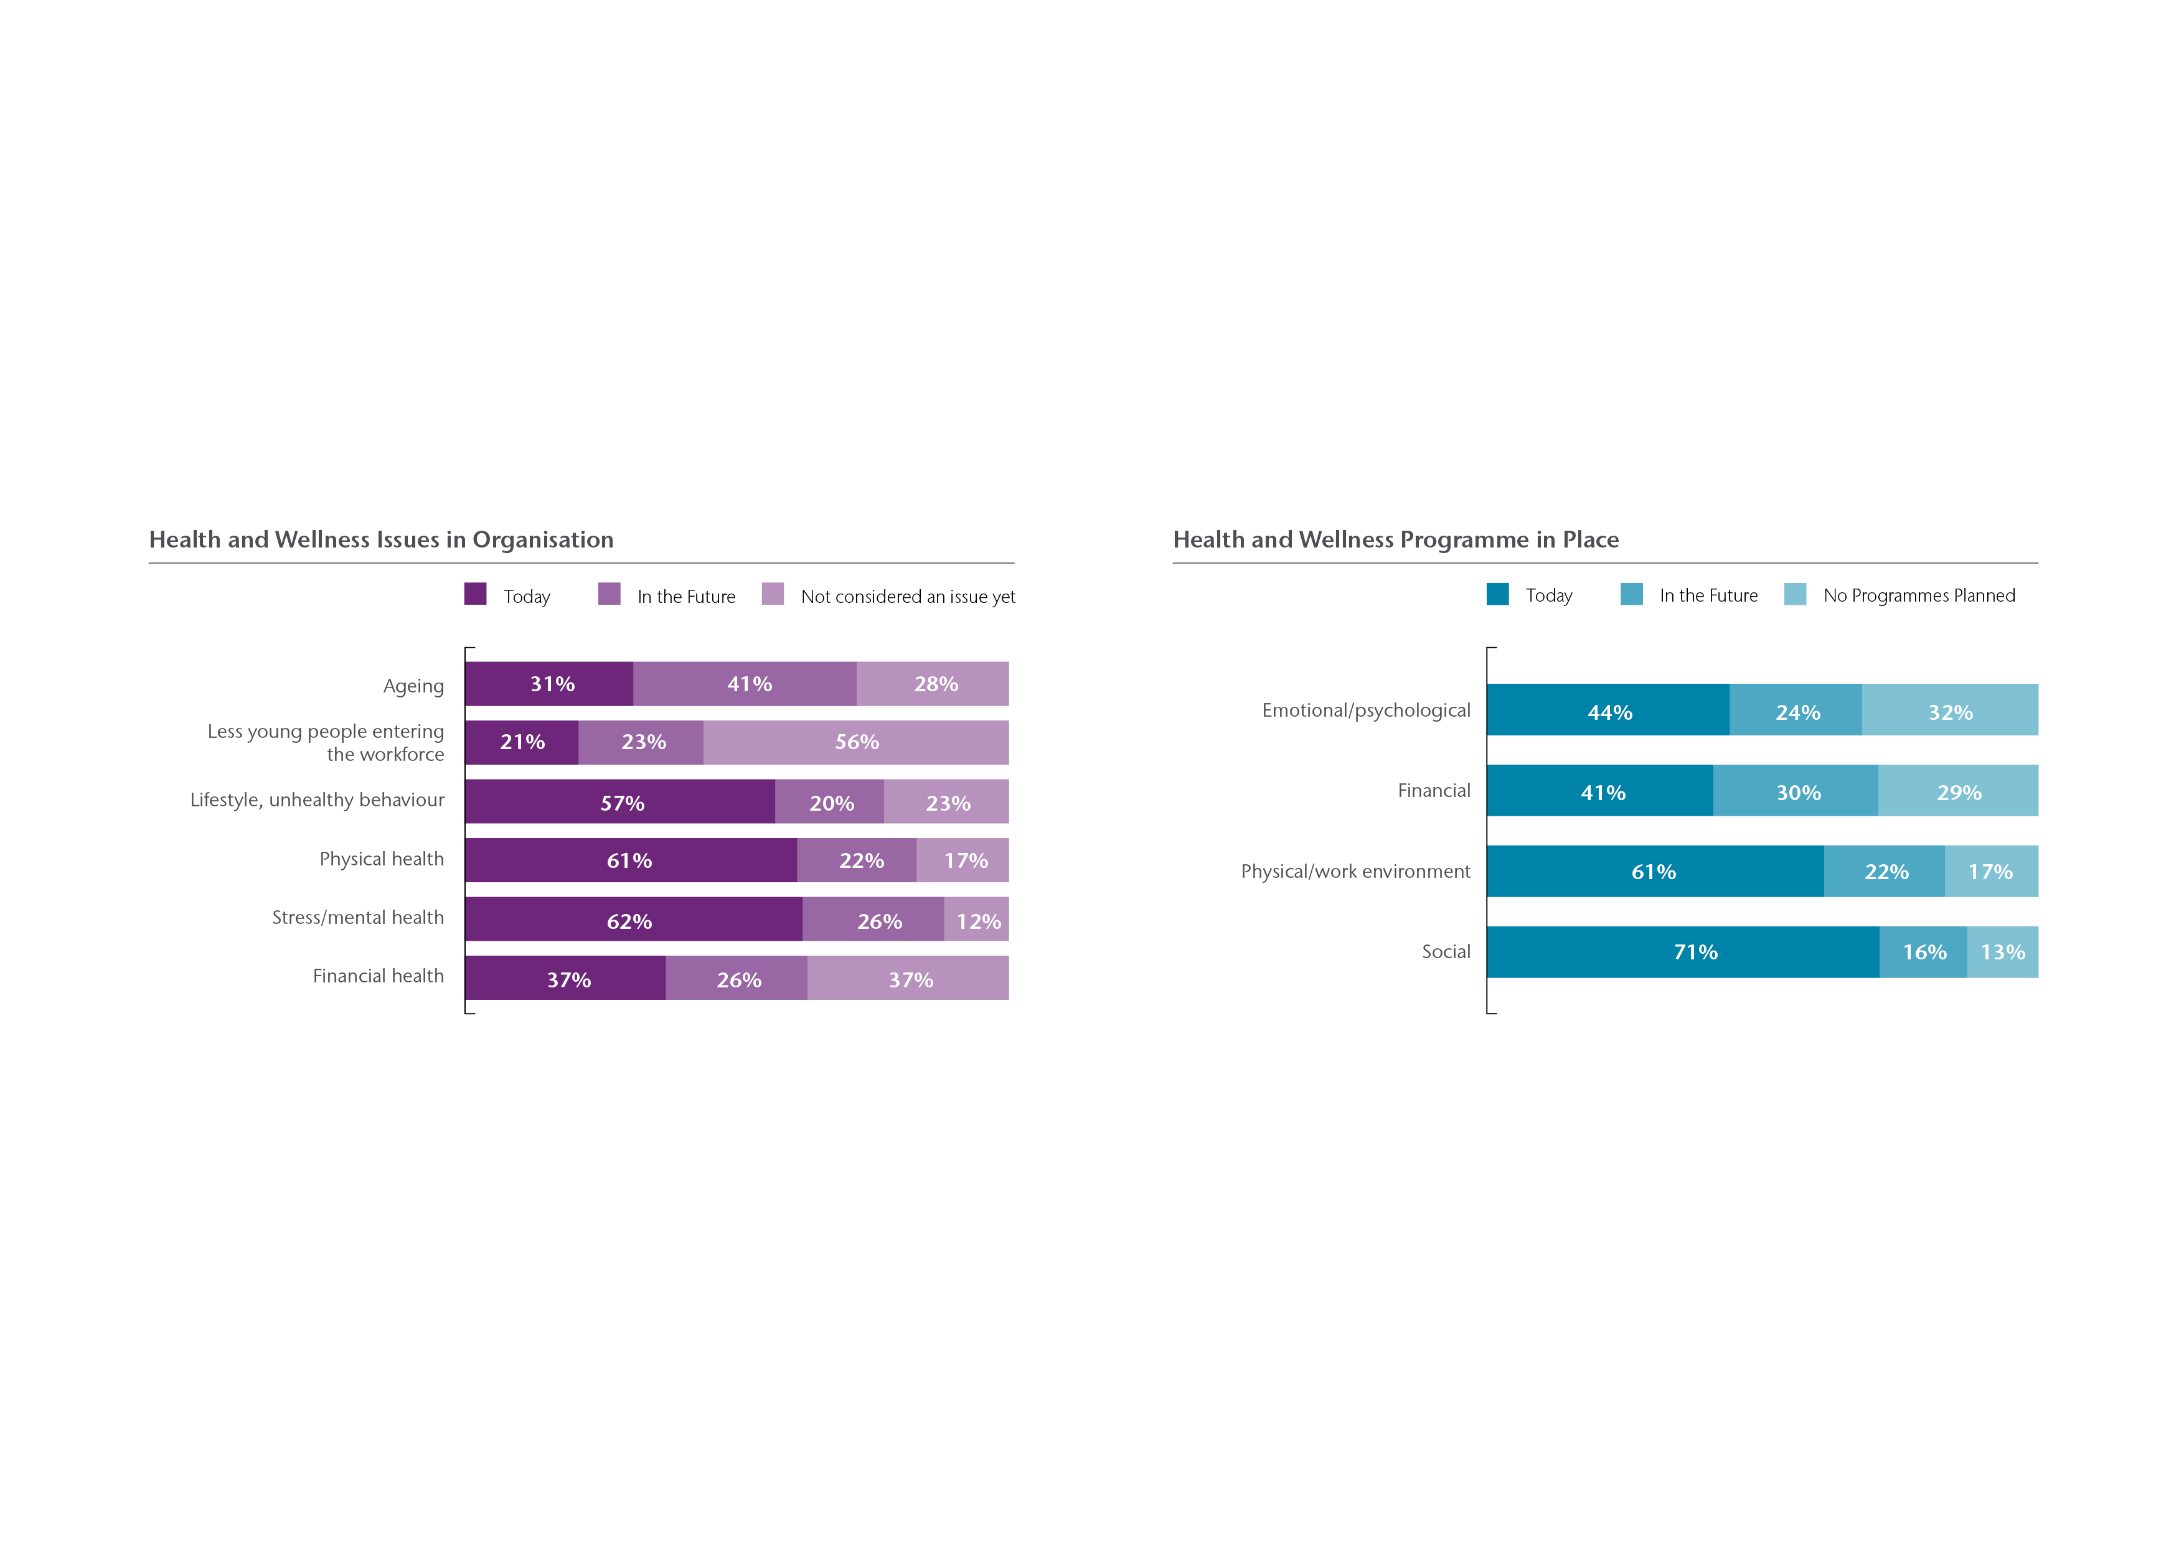
Health and Wellness
Lifestyle, Physical and Stress /Mental Health as Current and Future Pressing Issues
Consistent with Programmes Currently in Place
Ageing and Financial Health are Future Emerging Issues
Notes:
Key Points to Note:
Organizations viewed their employees’ lifestyle, unhealthy behavior, and physical and mention health as current pressing issues.
While they see ageing population and having lesser young people entering the workforce as future emerging challenges
Social programmes are highly prevalent today, closely followed by physical and work environment related programmes
Programs that focus on emotional / pysychological aspects and financial related wellness of employee lag but is expected to increase prominence in years ahead.

Slide 16
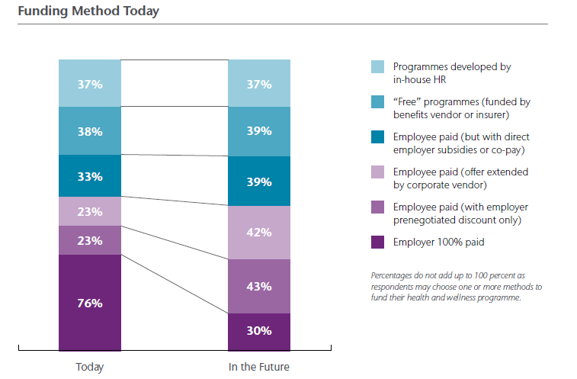
Funding Method Today
Funded by Various Parties
Employer Funding Expected to Reduce
Notes:
Key Points to Note:
The Study question allows multiple entries. The percentage represents respondents having each of the various funding methods (as a % of total). The bars therefore do not add to 100% but looking at change in % over time gives an indication of expected change in prevalence of each of the funding methods
On programme spend, existing health and wellness programmes are being funded by various parties
It ranges from in-house HR resource, ‘free’ programmes offered by benefit vendors, fully paid employer programmes, to employee direct paid offerings
Our study revealed that employees are expected to bear more of the cost of wellness programmes in future, with a corresponding reduction in employer funding
In summary, we are expecting companies to start taking a coordinated and holistic approach to health and wellness by incorporating emtional and financial wellness elements to the benefits offering
In an attempt to capture this opportunity, vendors are increasingly offering innovative solutions to meet these needs. There are also numerous opportunities to tailor funding of these programs to balance employer cost with employee participation.

Slide 17
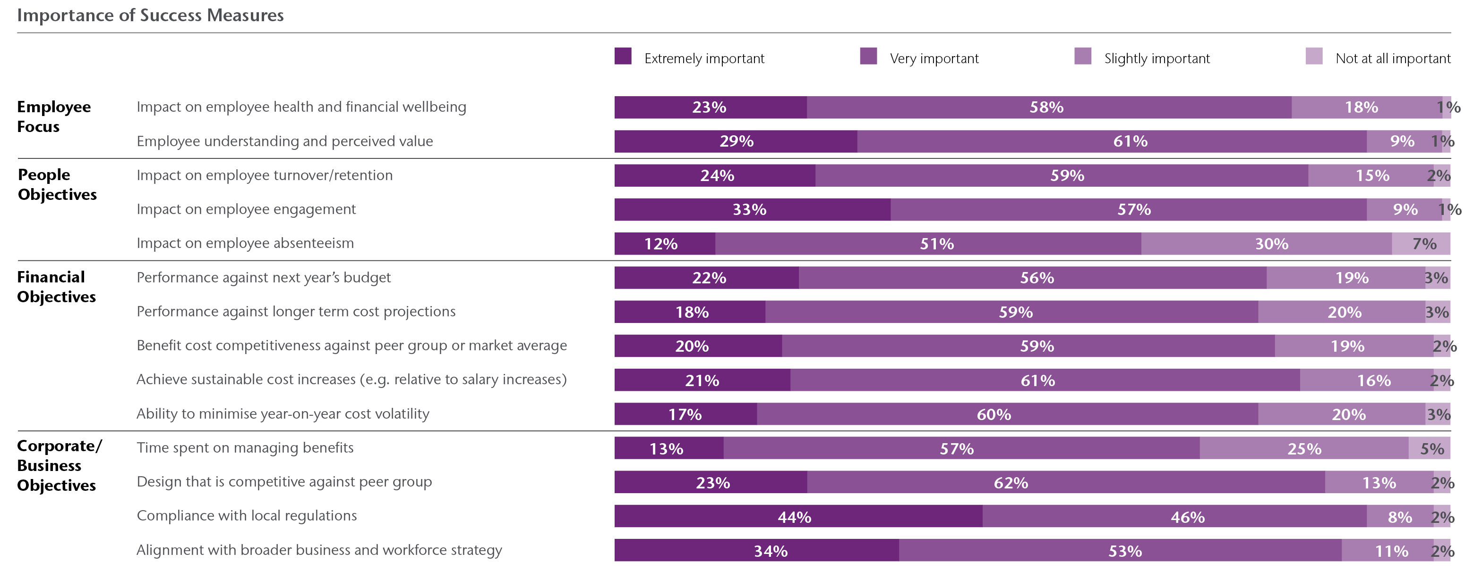
Top Success Measures
Alignment with Business and Workforce Strategy
Compliance with Local Regulations
Employee Engagement Impact
Employee Understanding and Perceived Value
Notes:
Key Points to Note:
Respondents indicated the following top success measures for their benefit programs
Alignment with broader business and workforce strategy
Compliance with local regulations
Impact on employee engagement
Achieving employee understanding and their perceived value of benefits they receive
Impact on employee absenteeism and time spent managing benefits are seen as least important
Collectively, it is encouraging to see most important success measures broadly align with key benefit focus areas identified earlier in this presentation
There is also an increasing focus on obtaining employee feedback, as you can see on the next chart

Slide 18
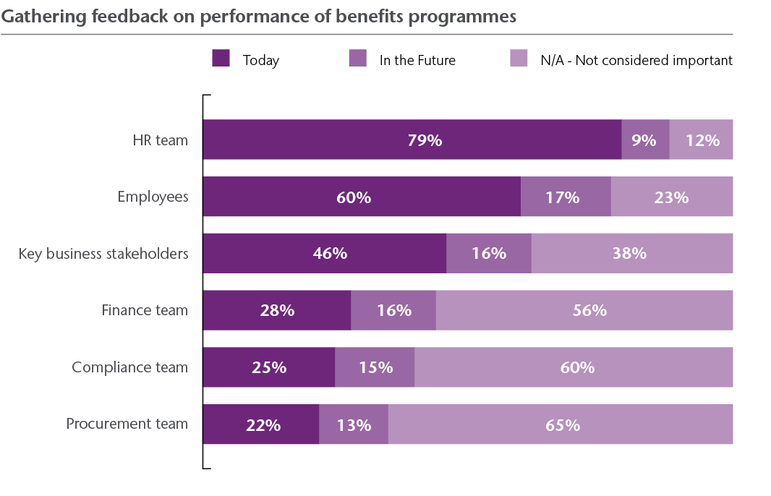
Feedback on Performance
Opportunities
Best Practice Annual Reviews
Obtain Feedback From Broad Set Of Stakeholders
Obtain Regular Employee Feedback
Compliance Metrics as Mandatory
Select Vendors and Adopt Technologies to Capture Success Measures
Notes:
Key Points to Note:
Benefits programme feedback is gathered mainly from HR stakeholders and employees
Feedback from finance, compliance and procurement is often not gathered.
We see the following opportunities for organizations;
Align best practice by establishing and reviewing success measures on an annual basis
Obtain feedback from a broad set of stakeholders, and not just HR and employees
And obtain employee feedback regularly, if employee engagement, exploring new benefits is important focus areas
Consider compliance is mandatory
Select vendors and adopt technologies that can capture relevant success measure data effectively

Slide 19
Interactive Session

Slide 20
2017 ASEAN Employee Benefits Survey
Understand over 40 types of prevalent and emerging benefits in the market
Include detailed plan design features for different groups of employees
Hassle-free process –no questionnaire to fill out.
Cost: USD1,000 per country
Indonesia, Malaysia, Philippines, Singapore, Thailand, Vietnam
Deadline to participate: Jul 2017

Slide 21
Thank you!
Thank you for participating in the study and attending the webinar.
Do reach out to your Aon consultant for a customised consultation based on your country, industry and role.

